Slide 1
NLP Project Presentation
Text Simplification using Transformer
Presented by : Vipasha Vaghela (202211002)
Dhruvi Shah(202211032)
Dipen Padhiyar(202211058)
Vivek Soni (202211069)

Slide 2
Introduction
Sentence simplification aims at making the structure of text easier to read and
understand while maintaining its original meaning.
This process is particularly beneficial for diverse user groups, including individuals with disabilities, language learners, and those with low literacy levels.
The primary goal involves simplifying sentence structures by removing complex vocabulary and rephrasing for which we have used purely pretrained models.
We have experimented with a combination of GPT-2 and BERT models, achieving the significantly better results compared to the previous state of the art.

Slide 3
Dataset Description
WikiLarge dataset, a compilation of data from Coster and Kauchak (2011) and other sources, totaling 296,000 sentence pairs.
For validation and testing, WikiSmall data and simplifications from Amazon Mechanical Turk workers were used, comprising 2,000 and 359 sentence pairs, respectively.

Slide 4
Literature Review
Historically, researchers have addressed sentence simplification using external linguistic databases or control tokens for fine-tuning. These methods have contributed valuable insights into the simplification process.
incorporation of additional linguistic knowledge to enhance the quality of generated simplified sentences.
simplification as a tagging problem akin to Named Entity Recognition. This involves suggesting edits (through tags) to a complex sentence, such as converting verbs to their simple/base form or replacing complex words.
integration of control tokens, and leveraging existing linguistic knowledge.

Slide 5
Proposed Approach
We introduced a novel approach to sentence simplification by leveraging fine-tuned transformer models.
Specifically, we employed a combination of transformer encoder and decoder models, namely BERT and GPT-2.
Our findings highlight the effectiveness of these models in achieving state-of-the-art results, with BERT emerging as the most impactful among the tested architectures.

Slide 6
Methodology

Slide 7
Methodology
We employed two widely used transformer models: BERT (Bidirectional Encoder Representations from Transformers) and GPT-2 (Generative Pre-trained Transformer 2).
The bidirectional nature of BERT allows it to capture contextual information comprehensively, potentially aiding in a deeper understanding of word meanings within sentences.
GPT-2, while unidirectional, excels in text generation tasks, demonstrating speed and efficiency.
We aim to demonstrate that the fine-tuning process alone, leveraging the intrinsic capabilities of large language models, is sufficiently effective for achieving notable performance in sentence simplification tasks.

Slide 8
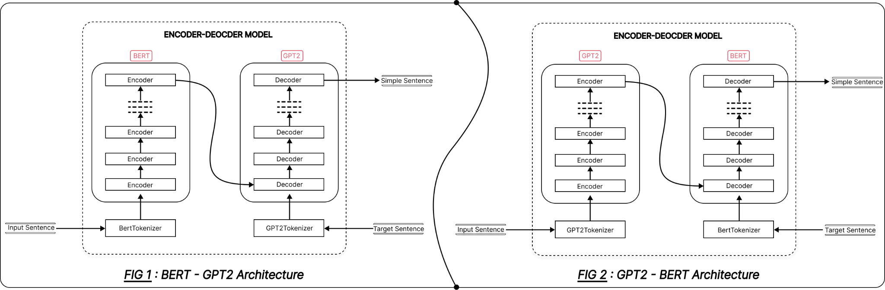

Slide 9
BERT-GPT-2 Model:
Combines BERT's bidirectional contextual understanding with GPT-2's text generation capabilities.
May provide a balance between understanding the context and generating coherent simplified text.
BERT Model:
Utilizes BERT for only encoding.
May capture bidirectional contextual information throughout the entire process.
Potentially more focused on preserving context.
GPT-2-BERT Model:
Uses GPT-2 to generate simplified text based on the contextual representation provided by BERT.
GPT-2's strong text generation capabilities may contribute to creative simplifications.
GPT-2 Model:
Employs GPT-2 for only decoding.
Allows the model to leverage GPT-2's generative power at both stages.
May produce simplified sentences with a consistent style and flow.

Slide 10
BERT
BERT's has contributed significantly due to its bidirectional architecture.
Tokenization: BERT's tokenization scheme is used to convert an input sentence into individual tokens, which are then divided into words or subwords.
Embedding Generation: Utilize BERT to generate embeddings for each token in the sentence, capturing contextual information and understanding relationships between words.
Simplification Strategy: Develops a strategy to simplify the sentence, targeting complex structures, difficult vocabulary, or intricate syntactic patterns.
Sentence Reconstruction: Generate a simplified version of the sentence based on the identified simplification strategy. Use BERT embeddings to aid in reconstructing the sentence while preserving grammatical correctness and essential meaning.

Slide 11
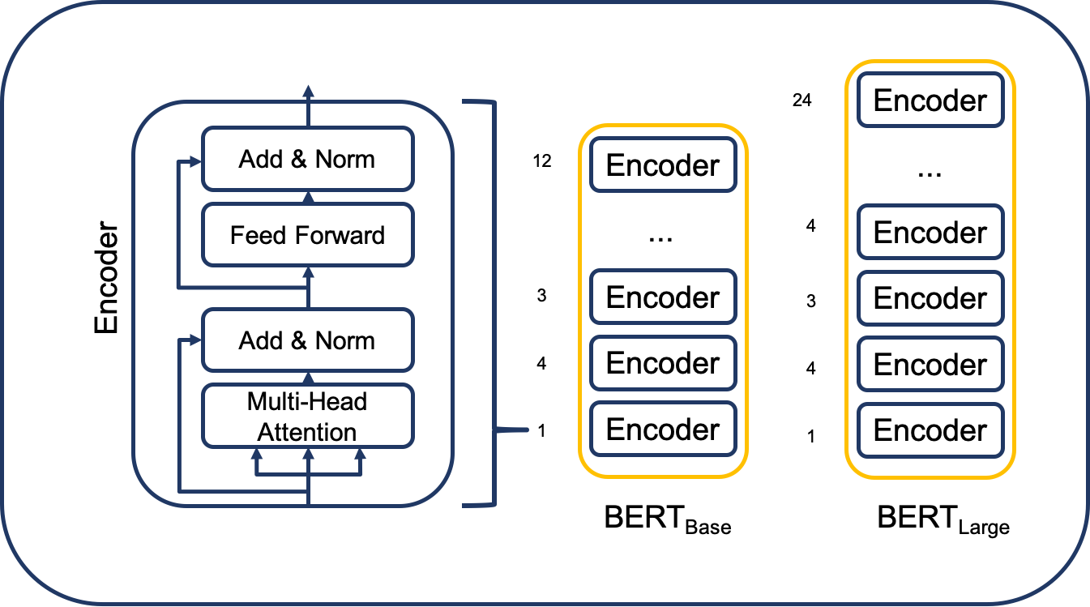
BERT architecture

Slide 12
GPT-2
GPT-2, a generative language model by OpenAI, is employed for sentence simplification.
Pre-training on a large corpus equips GPT-2 with language understanding, including grammar, semantics, and word relationships.
Fine-tuning tailors the model for sentence simplification using a specific dataset.
The original complex sentence serves as input to the fine-tuned GPT-2 model.
Input encoding transforms the sentence into a format understandable by GPT-2.
GPT-2 generates simplified text by drawing on its learned context, producing a sequence of words forming a simplified version.

Slide 13
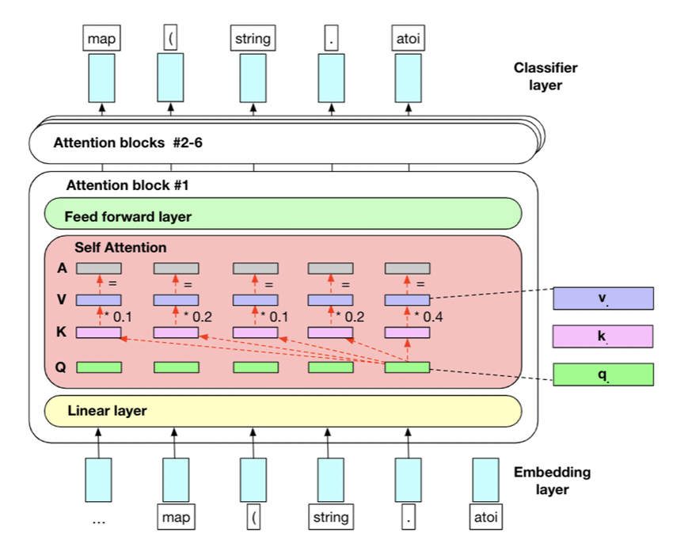
GPT2 architecture

Slide 14
Evaluation metrics

Slide 15
BLEU(Bilingual Evaluation Understudy)
Key components of BLEU are:
N-gram Precision
Brevity Penalty
Cumulative BLEU Score
BLEU score can be represented mathematically as:
Higher BLEU scores indicate better agreement between the generated and reference sentences in terms of n-gram precision, while considering penalties for brevity.

Slide 16
SAARI
SAARI is a lexical simplicity metric that measures “how good” are the words added, deleted and kept by a simplification model.
The metric compares the model’s output to multiple simplification references and the original sentence
The range of values for the SARI score is between 0 and 100 -- the higher the value, the better the performance of the model being evaluated.

Slide 17
Results

Slide 18
Models used | BLEU score | SAARI score
BERT | 0.2439 | 23.26
BERT-GPT2 | 0.2048 | 21.55
GPT2-BERT | 0.1768 | 16.34
GPT2 | 0.1971 | 18.67

Slide 19
Conclusion
This project proposes use of fine-tuned transformer models for sentence simplification, a process that simplifies complex sentences, particularly beneficial for individuals with disabilities, language learners, or low literacy.
Among the tested models, BERT emerged as the most effective, surpassing not only other models in this study but also outperforming previous state-of-the-art results.
The models performance has been tested on BLEU and SAARI.
The achieved SARI score of 46.80 on the Mechanical Turk dataset demonstrates the superior performance of the proposed transformer models.

Slide 20


